Slide 1
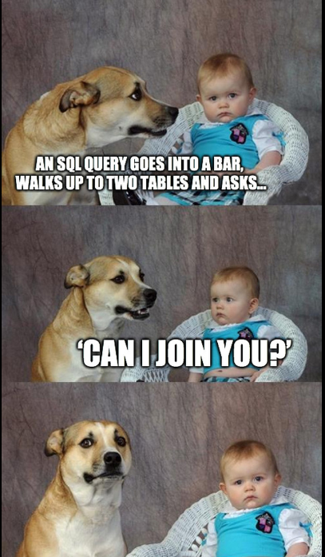

DAY 3 FUNCTIONS, GROUPPING, JOINS

Slide 2
RECAP DAY 2:
DML : select, insert, update, delete
Transactions
Structure of a select query + functions

Slide 3
Most commonly used functions:
The following slides shows the most commonly used functions that allow you to manipulate dates, strings, math operations effectively:

Slide 4
STRING functions:
CONCAT Concatenate two or more strings into one
LEFT Return the first n character in a string
LENGTH Return the number of characters in a string
LOWER Convert a string to lowercase
LPAD Left-pads a string with another string, to a certain length
LTRIM Remove the longest string that contains specified characters from the left of the input string
POSITION Return the location of a substring in a string
REPLACE Replace all occurrences of a substring in a string
REVERSE Return reversed string.
RIGHT Return last n characters in the string. When n is negative, return all but first |n| characters.
RTRIM Remove the longest string that contains specified characters from the right of the input string
SPLIT_PART Split a string on a specified delimiter and return nth substring
SUBSTRING Extract a substring from a string
TRIM Remove the longest string that contains specified characters from the left, right or both sides of a string
UPPER Convert a string to uppercase

Slide 5
DATE functions:
CURRENT_DATE Return the current date
CURRENT_TIME Return the current time
CURRENT_TIMESTAMP Return the current date and time with time zone at which the current transaction starts
DATE_PART Get a field of a timestamp or an interval e.g., year, month, day, etc.
DATE_TRUNC Return a timestamp truncated to a specified precision
EXTRACT Same as DATE_PART() function
LOCALTIME Return the time at which the current transaction start
LOCALTIMESTAMP Return the date and time at which the current transaction start
NOW Return the date and time with time zone at which the current transaction start
TO_DATE Convert a string to a date
TO_TIMESTAMP Convert a string to a timestamp
DATEADD Adds a time/date interval to a date and then returns the date.
DATEDIFF Returns the difference between two dates.

Slide 6
MATH functions:
ABS Calculate the absolute value of a number
CEIL Round a number up to the nearest integer, which is greater than or equal to number
DIV Return the integer quotient of two numeric values
EXP Return the exponential value in scientific notation of a number
FLOOR Round a number down to the nearest integer, which is less than or equal to number
LN Return the natural logarithm of a numeric value
MOD Divide the first parameter by the second one and return the remainder
ROUND Round a number to the nearest integer or to a specified decimal places
TRUNC Truncate a numeric value to a whole number of to the specified decimal places
RANDOM Return a random

Slide 7
Introduction to AGGREGATE functions
Aggregate functions perform a calculation on a set of rows and return a single row.
AVG() – return the average value.
COUNT() – return the number of values.
MAX() – return the maximum value.
MIN() – return the minimum value.
SUM() – return the sum of all values.
We often use the aggregate functions with the GROUP BY clause in the SELECT statement. In these cases, the GROUP BY clause divides the result set into groups of rows and the aggregate functions perform a calculation on each group e.g., maximum, minimum, average, etc.
You can use aggregate functions as expressions only in the following clauses:
SELECT clause.
HAVING clause.

Slide 8
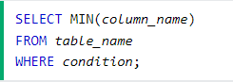
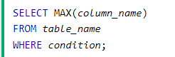
SQL MIN() and MAX() Functions
The MIN() function returns the smallest value of the selected column.
The MAX() function returns the largest value of the selected column.
MIN() Syntax: MAX() Syntax:
Example: Min and max age from accounts table
SELECT MIN(age), MAX(age)
FROM accounts

Slide 9
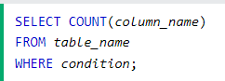
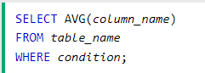
SQL COUNT(), AVG() and SUM() Functions
The COUNT() function returns the number
of rows that matches a specified criteria.
COUNT() Syntax:
The AVG() function returns the average value of a numeric column.
AVG() Syntax:
Example: Total number of books rentals
SELECT COUNT(*)
FROM books_rentals
Example: Average age from accounts table
SELECT AVG(age)
FROM accounts

Slide 10
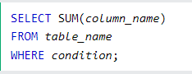
SQL COUNT(), AVG() and SUM() Functions
The SUM() function returns the total sum of a numeric column.
SUM() Syntax:
Example: Total amount of books
SELECT SUM(amount)
FROM books

Slide 11
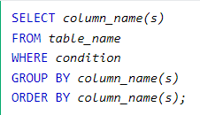
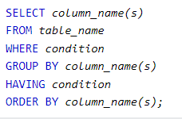
SQL: GROUP BY Statement and HAVING Statement
The GROUP BY statement groups rows that have the same values into summary rows.
The GROUP BY statement is often used with aggregate functions (COUNT(), MAX(), MIN(), SUM(), AVG()) to group the result-set by one or more columns.
The HAVING clause was added to SQL because the WHERE keyword cannot be used with aggregate functions.
GROUP BY Syntax:
HAVING Syntax:
Example: Find the days on which at least 5 books were rented
SELECT COUNT(*), date_rented
FROM book_rentals
GROUP BY date_rented
HAVING COUNT(*)>=5

Slide 12
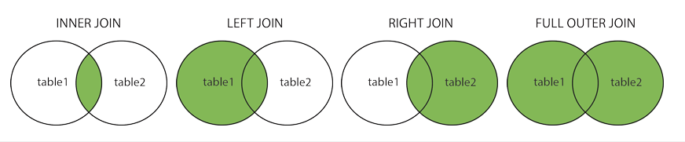
SQL JOINS:
A JOIN clause is used to combine rows from two or more tables, based on a related column between them.
Different Types of SQL JOINs
Here are the different types of the JOINs in SQL:
(INNER) JOIN: Returns records that have matching values in both tables
LEFT (OUTER) JOIN: Returns all records from the left table, and the matched records from the right table
RIGHT (OUTER) JOIN: Returns all records from the right table, and the matched records from the left table
FULL (OUTER) JOIN: Returns all records when there is a match in either left or right table

Slide 13
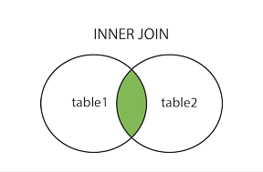
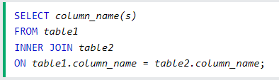
SQL INNER JOIN:
The INNER JOIN select records that have matching values in both tables.
INNER JOIN Syntax:
Example: All the account_ids that rented a book:
SELECT accounts.account_id
FROM accounts
INNER JOIN book_rentals
ON accounts.account_id = book_rentals.account_id

Slide 14
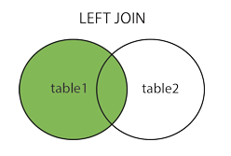
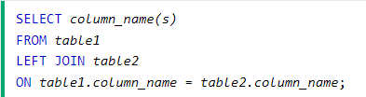
SQL LEFT JOIN:
The LEFT JOIN return all records from the left table (table1), and the matching records from the right table (table2).
LEFT JOIN Syntax:
Example: All the books and their genres
SELECT books.book_id, genres.name
FROM books
LEFT JOIN genres
ON books.genre_id = genres.genre_id
Note: In some databases LEFT JOIN is called LEFT OUTER JOIN.

Slide 15
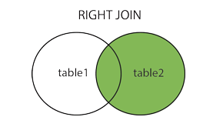
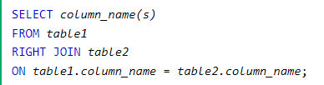
SQL RIGHT JOIN:
The RIGHT JOIN keyword returns all records from the right table (table2), and the matching records from the left table (table1).
RIGHT JOIN Syntax:
Example: All the books and any rental detail if available
SELECT books.book_id, book_rentals.details
FROM books
RIGHT JOIN book_rentals
ON books.book_id = book_rentals.book_id
Note: In some databases RIGHT JOIN is called RIGHT OUTER JOIN.

Slide 16
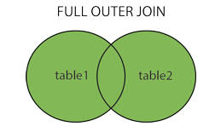
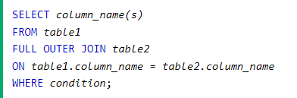
SQL FULL OUTER JOIN:
The FULL OUTER JOIN keyword returns all records when there is a match in left (table1) or right (table2) table records.
FULL OUTER JOIN Syntax:
Example: All account_ids and all rentals:
SELECT accounts.*, book_rentals.*
FROM accounts
FULL JOIN book_rentals
ON accounts.account_id = book_rentals.account_id
Tip: FULL OUTER JOIN and FULL JOIN are the same.

Slide 17
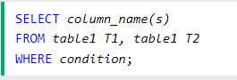
SQL SELF JOIN:
A self join is a regular join, but the table is joined with itself.
SELF JOIN Syntax:
T1 and T2 are different table aliases for the same table.
Example: All the account_ids that have the same age:
SELECT a1.account_id, a2.account_id, a1.age
FROM accounts a1
INNER JOIN accounts a2
ON a1.age= a2.age
AND a1.account_id <> a2.account_id

Slide 18
Window functions:
Similar as an aggregate function, a window function operates on a set of rows. However, it does not reduce the number of rows returned by the query.
The term window describes the set of rows on which the window function operates. A window function returns values from the rows in a window.
PARTITION BY clause
The PARTITION BY clause divides rows into multiple groups or partitions to which the window function is applied.
The PARTITION BY clause is optional. If you skip the PARTITION BY clause, the window function will treat the whole result set as a single partition.
ORDER BY clause
The ORDER BY clause specifies the order of rows in each partition to which the window function is applied.
The ORDER BY clause uses the NULLS FIRST or NULLS LAST option to specify whether nullable values should be first or last in the result set. The default is NULLS LAST option.

Slide 19
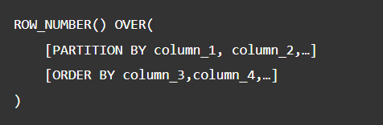
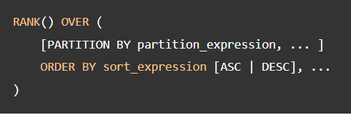
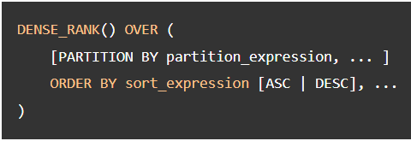
Window functions:
The ROW_NUMBER(), RANK(), and DENSE_RANK() functions
The ROW_NUMBER(), RANK(), and DENSE_RANK() functions assign an integer to each row based on its order in its result set.
The ROW_NUMBER() function assigns a sequential number to each row in each partition.

Slide 20
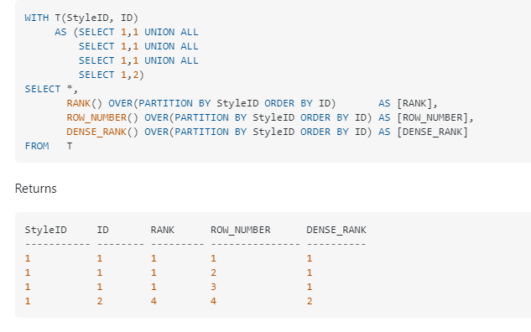
RANK and DENSE_RANK are deterministic in this case, all rows with the same value for both the ordering and partitioning columns will end up with an equal result, whereas ROW_NUMBER will arbitrarily (non deterministically) assign an incrementing result to the tied rows.

Slide 21
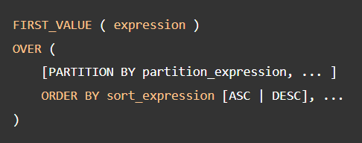
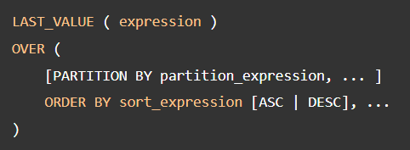
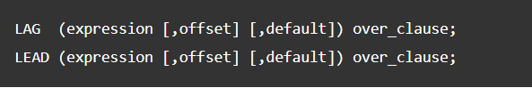
Window functions:
The FIRST_VALUE and LAST_VALUE functions
The FIRST_VALUE() function returns a value evaluated against the first row within its partition, whereas the LAST_VALUE() function returns a value evaluated against the last row in its partition.
The LAG and LEAD functions
The LAG() function has the ability to access data from the previous row, while the LEAD() function can access data from the next row.
Both LAG() and LEAD() functions have the same syntax as follows:
expression – a column or expression to compute the returned value.
offset – the number of rows preceding ( LAG)/ following ( LEAD) the current row. It defaults to 1.
default – the default returned value if the offset goes beyond the scope of the window. The default is NULL if you skip it.

Slide 22
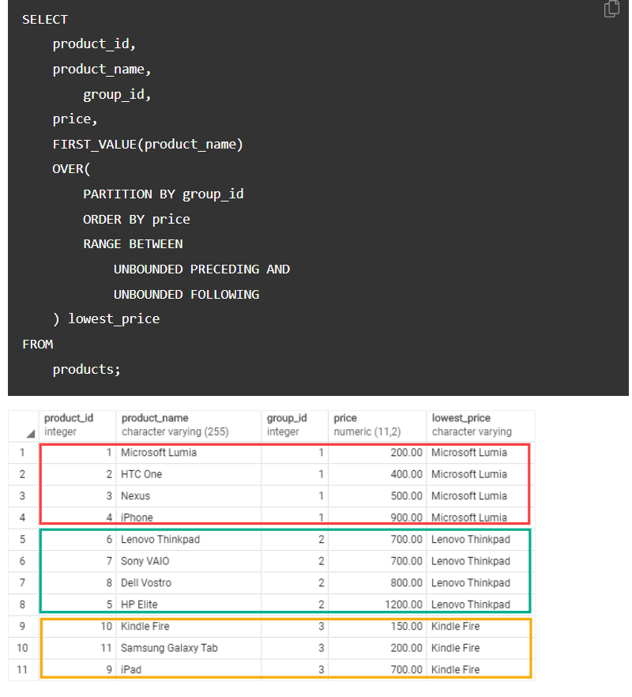

Slide 23
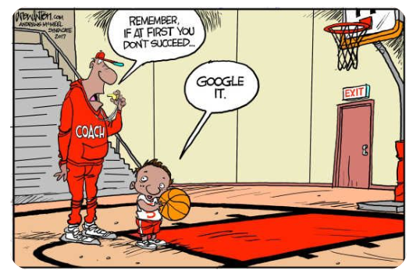
THANK YOU

Slide 24
Exercises:
1. Get the list with FULL NAMES and ages of the accounts ordered by age.
2. Get the number of rentals (per day) from the last 10 days in descending order (by the number of rental).
3. Create a query to display all the Romance authors (without duplicates) in ascending order.
4. Get the list of the emails, book_names, return_date for the accounts that rented a book yesterday, yesterday -1 .
5. Get all the rentals for the book_ids and titles that were rented at least twice
6. Select all the accounts and all the rentals. (without acc id 16,17)
7. Get the total number of rentals for each genre.
8. Find all the authors that also rented books from the same library.
9. Get the total number of accounts grouped by the first letter of their last name in alphabetical order.
10. Get the total number of characters, display the 4th word and replace it with ‘Jane’ for the title = ‘The Diary of Anne Frank’
11. Find all the email addresses of the accounts that were registered multiple times (based on their full names)
12. A rare book is one for which the library has at most 3 copies (amount field). Please write the SQL that returns all the accounts (Name, Email, Phone Number) that have at least 2 rare books rented not returned.

